Slide 1
Anesthesia for biliary tract diseases
MERON A,
Sep,2024

Slide 2
Contents
Introduction to biliary system
Bilirubin metabolism
Hyperbilirubinemia
Biliary tract diseases
  Obstructive jaundice
  Acute cholecystitis

Slide 3
Introduction
Bile is a bitter-tasting, dark green to yellowish brown fluid, produced by the liver.
Bile aids the process of digestion and absorption of lipids in the small intestine
Bile is made of the following constituents: water (85%), bile salts (10%), pigments (3%), fats (1%), inorganic salts (0.7%) and cholesterol (0.3)
The bile secreted by hepatocytes flows into small ducts in rt and lt lobes of the liver join to form two larger ducts forming rt and lt hepatic ducts

Slide 4
These two bile ducts immediately join to form one bile duct called the common hepatic duct.
The common hepatic duct merges with the cystic duct from the gallbladder to form the common bile duct
The latter opens into the descending part of duodenium together with pancreatic duct (ampulla of Vater)
Hepatobiliary disease is often characterized by cholestasis, the suppression or stoppage of bile flow.

Slide 5
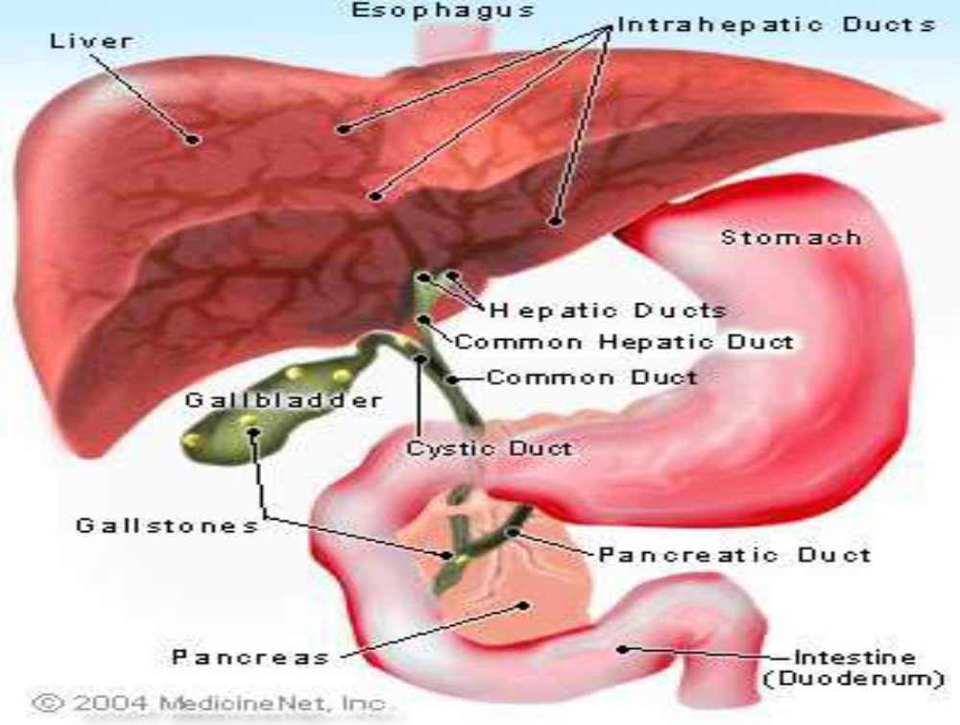

Slide 6
Bilirubin metabolism
Bilirubin is synthetized from destruction of aged erythrocytes in RE cells. About 6 g of Hb is broken down per day
A total of 300 mg of bilirubin is formed everyday; of which 80% is from destruction of old RBCs, 10% from ineffective erythropoiesis and the rest 10% from degradation of myoglobin and other heme containing proteins.
The bilirubin produced in RES is insoluble in water and transported to liver combined to albumin.

Slide 7
Albumin binds bilirubin in loose combination. So when present in excess, bilirubin can easily dissociate from albumin
When the albumin–bilirubin complex reaches the sinusoidal surface of the liver, the bilirubin is taken up and became conjugated with glucoronic acid
The binding sites for bilirubin on albumin can be occupied by aspirin, penicillin, etc. Such drugs can, therefore, displace bilirubin from albumin. Hence, care should be taken while administering such drugs to newborn babies to avoid kernicterus

Slide 8
The water soluble conjugated bilirubin is excreted into the bile and reaches the intestine
In the small intestine, conjugated bilirubin is poorly reabsorbed and partly hydrolyzed back to unconjugated bilirubin by catalytic action of bacterial ß-glucuronidases
A multistep hydrolysis of unconjugated bilirubin to urobilinogen w/c is further reduced to stercobilinogen
Upto 20 % of urobilinogen produced daily is reabsorbed from the intestine & enters the entero-hepatic circulation

Slide 9
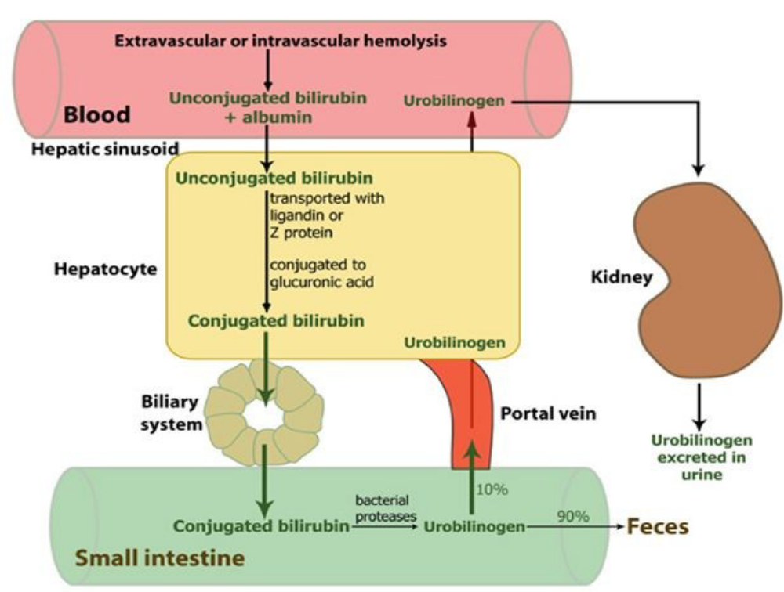
Fig. bilirubin metabolism

Slide 10
Hyperbilirubinemia
Disruption of bilirubin metabolism and excretion can cause hyperbilirubinaemia and subsequent jaundice
Hyperbilirubinaemia maybe unconjugated (indirect) or conjugated (direct) depending on the cause
This may be due to abnormalities in the formation, transport, metabolism, and excretion of bilirubin
Normal values:
  Total bilirubin: 0.3–1.3 mg/dL
  Direct bilirubin: 0.1–0.4 mg/dL
  Indirect bilirubin: 0.2–0.9 mg/dL

Slide 11
Jaundice(icterus)
Jaundice is a yellow discoloration of the skin, mucous membranes, and sclera caused by increased amounts of bilirubin in the blood.
A serum bilirubin concentration of 3 mg/dL results in scleral icterus and a level above 4 mg/dL causes overt jaundice
It occurs when the equilibrium between bilirubin production and clearance is disturbed

Slide 12
Types
  Prehepatic: any pathology before reaching to the liver. Due to increased RBC destruction.
  Intrahepatic: pathology occuring within the liver. Caused by the liver’s inability to properly metabolize and excrete bilirubin.
  Post-hepatic (obstructive): pathology occuring after conjugation of bilirubin within the liver. Any cause of biliary obstruction (e.g. Gallstones) causing impedance to bile flow
Notes:
Prehepatic:Examples of conditions with increased
breakdown of red blood cells include: Malaria, Sickle cell crisis, Spherocytosis, Thalassemia, Glucose-6-phosphate dehydrogenase deficiency, Drugs or other toxins, and Autoimmune disorders.
Hepatic:Viral – hepatitis A, B, or C, yellow fever, Bacterial, sepsis, tuberculosis, Alcohol, Drugs e.g. estrogens, contraceptive pills and Pregnancy, Carcinoma: metastases. Lymphoma, Adenocarcinoma of kidney, Chronic active hepatitis

Slide 13
Obstructive jaundice
Occurs due to excess accumulation of conjugated bilirubin
This must be differentiated from intrahepatic jaundice(due to suppression or obstruction of bile flow at the level of the hepatocyte or bile canaliculus)
Obstruction may be intrahepepatic or extrahepatic
Patients with complete or near-complete obstruction present with progressive jaundice, a dark urine with pale stools, and pruritus.
Notes:
Obstructive jaundice must be differentiated from intrahepatic cholestasis. The latter is due to suppression or obstruction of bile flow at the level of the hepatocyte or bile canaliculus. Intrahepatic cholestasis most commonly results from viral hepatitis or an idiosyncratic drug reaction (most often reactions to phenothiazines or oral contraceptives). The treatment for extrahepatic obstruction is usually surgical, whereas that for intrahepatic cholestasis is medical. Although pruritus (due to retained bile salts) is a prominent feature of intrahepatic cholestasis, correct diagnosis may not be possible based on clinical or laboratory grounds. Both entities produce a predominantly conjugated (> 50%) hyperbilirubinemia and moderate to marked elevations of serum alkaline phosphatase. Imaging studies (ultrasound, cholangiograms, radioisotopic or computed tomographic [CT] scans) are necessary to confirm extrahepatic biliary obstruction.
Gallstone disease (cholelithiasis) limited to the gallbladder is often asymptomatic and may affect 10–20% of the general population. The diagnosis is usually made by abdominal ultrasound. Symptomatic individuals usually present with biliary colic secondary to obstruction of the cystic duct. The triad of sudden right upper quadrant tenderness, fever, and leukocytosis suggests cholecystitis. The diagnosis can be confirmed by failure of the gallbladder to visualize on a radioisotope scan. Passage of a gallstone through the common duct may also produce transient jaundice (above). Concomitant chills or high fever may indicate an ascending bacterial infection of the biliary system (cholangitis). Less commonly, the gallstone can obstruct the pancreatic duct and cause acute pancreatitis. Approximately 75% of episodes of acute cholecystitis resolve within 2–7 days following medical treatment. The remaining 25% have a course complicated by failure to resolve the episode, empyema, perforation, gangrene, hydrops, fistula formation, or gallstone ileus. Five to ten percent of patients with an acute attack have acalculous cholecystitis. The latter typically occurs following or in association with serious trauma, burns, prolonged labor, major surgery, or critical illness. The diagnosis is usually made by ultrasound or CT scan of the abdomen.

Slide 14
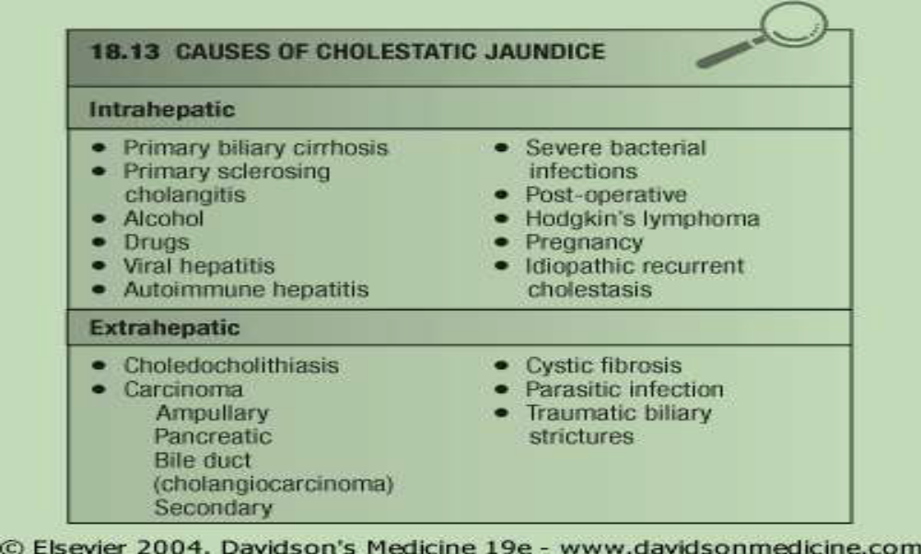

Slide 15
Pathogenesis
Altered blood chemistry
  Elevated biochemical indexes(total/conjugated bilirubin, bile acids, cholesterol, ALP, transaminases) in jaundiced patients as compared with those in nonjaundiced patients.
  ALP is a reliable indicator of cholestasis.
  ALT is an enzyme from the cytoplasm of the liver, its increase is not apparent in the early stages of biliary obstruction, but it can be significantly increased when the synthesis of liver cell was damaged
  The serum AST rises in patients with biliary obstruction, especially acute infections is present

Slide 16
Malnutrition
  Is common in patients with obstructive jaundice because of their poor gastrointestinal absorption and malabsorption of fats and steatorrhea
  The impaired enterohepatic circulation can easily cause fat-soluble vitamin deficiency.
  Patients with obstructive jaundice are susceptible to night blindness because of vitamin A deficiency
  Vitamin D deficiency and chronic cholestasis can lead to hepatic osteopathy.
  Neuromuscular weakness in children is due to vitamin E deficiency

Slide 17
CVS dysfunction
  Depressed cardiac function and blunted responses to vasoactive substances
  Bile acids have direct effects on myocytes, and can influence myocardial conduction and contraction
  Defects in myocardial performance is thought to play an important role in the physiopathology of MODS
  Patients with both acute and chronic biliary obstruction are at particular risk for hypotension after surgery to relieve the obstruction

Slide 18
In general,
  Decreased cardiac contractility,
  Reduced LV contraction,
  Impaired response to beta agonist drugs
  PVR and BP are declined, and
  The blood vessels become insensitive to endogenous and exogenous stressors
  Bradycardia due to direct effect of bile salt on SA node
Hypotensive, bradycardic and exaggerated hypotensive response to volume depletion and cardiovascular depressants

Slide 19
Renal system
  Acute renal failure is a serious consequence of obstructive jaundice
  Most scholars believe that damage to the normal function of the circulatory system and decompensation of the circulatory system may be the main cause of renal failure
  Hypotension, sepsis, depletion of extracellular fluid, myocardial dysfunction, hypoproteinemia, hyponatremia, and hypokalemia have proven to be closely related to the development of kidney disease in patients with obstructive jaundice

Slide 20
GI system
  Obstructive jaundice can damage the gastrointestinal mucosal barrier, causing stress ulcer and intestinal bacterial translocation
  Intestinal mucosal barrier dysfunction and increased gut permeability enabling intestinal pathogens and endotoxin to invade into the mesenteric lymph nodes, portal vein circulation and the liver.
  The exact mechanism of increased intestinal permeability in obstructive jaundice remains unclear.
  Intestinal bacterial translocation and accompanied endotoxin can lead to sepsis and multi-organ failure

Slide 21
Hepatic system
  A severe liver injury is one of the main consequences of obstructive jaundice
  Obstructive jaundice-related hepatic injury includes hepatocellular necrosis and apoptosis, bile duct epithelial cell proliferation, and liver fibrosis
  Endotoxemia, inflammatory cell infiltration, and microvascular perfusion failure are involved

Slide 22
Hematologic
  Coagulopathy -fat-soluble vitamin K malabsorption and affect the synthesis of coagulation factors VII, IX and X, thus reducing the level of prothrombin in the liver and increasing the risk of bleeding.
  The impaired production of coagulation factors by the damaged hepatocytes is superimposed by the poor absorption of vitamin K due to the absence of bile in the gut.
  The occurrence of DIC in obstructive jaundice and its relation to biliary tract infection has been early recognized

Slide 23
Immune system
  Immune function, especially cellular immunity, is inhibited in obstructive jaundice
  Patients with a weakened immune system are more susceptible to endotoxemia than those immunocompetent patients, and
  Endotoxemia in turn can aggravate impairment to the immune function

Slide 24
Anesthetic management
Preoperative assessment
  Careful history that pertains to each system should be obtained
  Cardiovascular function and volume status should be assessed and corrected accordingly
  Preoperative renal protection protocol including prevention of hypovolemia; avoidance of using nephrotoxic drugs such as aminoglycoside antibiotics and non-steroidal antipyretic analgesics
  Nutritional status of the patient should be carefully sought high protein and carbohydrate diet but low fat recommended

Slide 25
History of easy bruising from skin surface, itching, GI bleeding, urine and stool color
Presence and duration of jaundice should be assessed
Preoperative coagulopathy can be corrected with intramuscular vitamin K (10mg) usually initiated 3 days before surgery
Fresh frozen plasma can be considered when vitamin K is invalid.
Use therapeutic strategies to reduce preoperative endotoxemia such as use of antibiotics; active liquid therapy

Slide 26
Lab. Investigations
  CBC
  Liver function tests(albumin, ALP and transaminases)
  Serum bilirubin level(total, direct and indirect)
  Coagulation studies(PT, INR, PTT and bleeding time)
  Renal function tests
  Serum electrolytes
  ECG and echo

Slide 27
Intraoperative
Anesthetic selection
  Both regional and general anesthesia can be successfully utilized
  TEA is reported to have a protective effect on intestinal barrier function and could improve intestinal microcirculation and increase gastrointestinal local blood flow
  TEA can provide relatively stable hemodynamics, and does not affect the tissue perfusion of the vital organs, thus playing a role in protecting the intestinal barrier function

Slide 28
General anesthesia with endotracheal intubation is safer and has a better anesthetic effect, a lower incidence of hypotension and a good response to ephedrine.
However, tracheal intubation has poor drug tolerance and is associated with a relatively high incidence of delayed recovery after general anesthesia
General anesthesia combined with epidural block can avoid the disadvantages of the above two
It can maintain more stable hemodynamics and provide a perfect anesthetic effect.

Slide 29
The choice of intravenous sedatives is very important for general anesthesia induction and intraoperative maintenance in patients with obstructive jaundice
At present, anesthesia of target-controlled infusion (TCI) with propofol is still a popular choice. Associated with lower incidence of N/V
Propofol usage has similar pharmacokinetics in both jaundiced and non jaundiced patients
Thiopental has low hepatic extraction and can be used alternatively

Slide 30
Inhalation Anesthetics
  Obstructive jaundice is often accompanied with liver damage, so hepato-nephrotoxic drugs such as halothane should be avoided
  Enflurane has no significant adverse effect on liver function and therefore is not contraindicated for use in hepatobiliary patients
  MAC-awake was reduced in patients with obstructive jaundice, probably due to hyperbilirubinemia
  The higher the plasma bilirubin level is, the lower the MAC-awake would be.

Slide 31
In addition, the sensitivity to isoflurane was enhanced in jaundiced patients and therefore they were more likely to develop hypotension and bradycardia during anesthesia induction and maintenance
Therefore, the dosage of inhalation anesthetics should be relatively reduced in patients with obstructive jaundice, and intraoperative monitoring should be emphasized, especially in patients who receive a single inhalation anesthetic agent.

Slide 32
Muscle relaxants
  The muscle relaxant, which is metabolized through the liver, excreted via the biliary tract, and could slow the heart rate, should not be used in jaundiced patients
  Succinylcholine can excite the vagus nerve and is likely to cause bradycardia or ventricular arrhythmia
  It is preferable to use short-acting nondepolarizing muscle relaxants.
  Atracurium and cisatracurium are the choice of muscle relaxants for jaundiced patients

Slide 33
Repeated use of atracurium or cisatracurium would not cause accumulation of the drug in the body
Rocuronium is widely used for clinical anesthesia due to its short onset time and intermediate duration of action but it is eliminated unchanged primarily in bile, while urinary elimination is a secondary pathway
To reduce the occurrence of pulmonary complications and postoperative residual neuromuscular blockade in the perioperative period, objective neuromuscular monitoring

Slide 34
Opioid Analgesics
  Compared with healthy people, the dosage of analgesics can be reduced by about 50% in patients with obstructive jaundice-increased release of endogenous opoids
  Patients with obstructive jaundice have increased pain threshold than non jaundiced patients
  All opioid analgesics can cause biliary sphincter spasm and an increase in bile duct pressure, and this effect of morphine can last for about two hours.

Slide 35
Fluid Management
  Fluid administration is one of the essential preventative strategies to control the postoperative complications and mortality in patients with obstructive jaundice
  The basic aim of the fluid management during the period of operation is to increase the left ventricular stroke volume for avoiding cardiopulmonary complications and interstitial edema
  Volume depletion was related to hemodynamic and renal disturbances in patients with obstructive jaundice

Slide 36
Giving sufficient solution and providing strong hemodynamic support were the effective therapy to expand the ECV in the perioperative period

Slide 37
Post-operative
  Extubation at the end can be considered in patients with stable hemodynamics and fully reversed of muscle paralysis
  In unstable patients, elective admission to ICU and post operative ventilation would be considered
  Post-operative fluid requirements should be well addressed to prevent acute renal failure
  Appropriate fluid type should rationally be replaced and responsiveness guided by essential monitors(CVP, PCWP, UOP)

Slide 38
Post-operative pain management
  Low dose opioids well tolerated
  Avoid NSAIDs and other hepato-renotoxic drugs
  Nerve blocks can be performed in patients with normal coagulation
  Indwelling epidural catheter can be used for postoperative management

Slide 39
Acute cholecystitis
Defined as acute inflammation of gall bladder
Obstruction of the cystic duct or common bile duct by a gallstone causes acute inflammation.
Cholelithiasis is present in 95% of patients with acute cholecystitis
Patients who have gallbladder or biliary tract stones can exhibit no symptoms (silent disease), acute symptomatic disease, or chronic intermittently symptomatic disease

Slide 40
Signs and symptoms
  nausea, vomiting, fever, abdominal pain, and right upper quadrant tenderness
  Biliary colic, a severe pain that begins in mid epigastrium and moves to RUQ and may radiate to back
  This pain is extraordinarily intense and usually begins abruptly and subsides gradually
  Patients may notice dark urine and scleral icterus

Slide 41
Patients with a clinical diagnosis of acute cholecystitis are treated with intravenous fluids and opioids to manage the pain
Febrile patients with leukocytosis are given antibiotics
N/V should be controlled with antiemetics
Surgery is typically considered when the patient's condition has stabilized

Slide 42
Anesthesia for cholecystectomy
Laparoscopic cholecystectomy is the procedure of choice
However, laparoscopic cholecystectomy can be converted to open cholecystectomy in approximately 5% of patients because inflammation obscures the anatomy
Patients with septic shock, peritonitis, pancreatitis, or coagulopathy may undergo open cholecystectomy or ultrasonographically guided percutaneous cholecystostomy
Anesthetic considerations for laparoscopic cholecystectomy are similar to those for other laparoscopic procedures

Slide 43
Insufflation of the abdominal cavity (pneumoperitoneum) results in increased intraabdominal pressure that may interfere with the adequacy of ventilation and venus return
Changes in cardiovascular function resulting from insufflation include
  An immediate decrease in venous return and cardiac output and
  An increase in mean arterial pressure and systemic vascular resistance
Placement of the patient in reverse trendelenburg's position favors movement of abdominal contents away from the operative site and may improve ventilation.

Slide 44
Preoperative
  Most patients with acute cholecystitis are stabilized medically prior to cholecystectomy.
  Medical treatment includes nasogastric suction, intravenous fluids, antibiotics, and analgesics
  Those in whom the acute attack resolves may defer surgery for a later time, whereas those suffering serious complications may require emergency cholecystectomy
  Patients with extrahepatic biliary obstruction from whatever cause readily develop vitamin K deficiency with a consequent coagulopathy

Slide 45
Correction of coagulopathy is recommended
High bilirubin levels may be associated with an increased risk of postoperative renal failure; generous preoperative hydration is advised
Long-standing extrahepatic obstruction (> 1 year) produces secondary biliary cirrhosis and portal hypertension
Preoperative anxiety can be alleviated with short acting anxiolytics

Slide 46
Intraoperative
  General anesthesia with ETTI and muscle relaxation is anesthetic technique of choice
  In short procedures and in certain patients, ventilation using supraglottic airway device can be used as an alternative
  The uses of rapid and short acting volatile anesthetics such as sevoflurane and desflurane as well as rapid and short acting intravenous drugs such as propofol, etomidate, remifentanil, fentanyl, atracurium, vecuronium and rocuronium are commonly used and had better rcovery profile

Slide 47
In patients with biliary tract obstruction, a prolonged duration of action of drugs primarily dependent on biliary excretion should be anticipated
Agents dependent on renal elimination are preferable
The use of opioids during anesthesia for this operation is controversial because these drugs can cause spasm of the sphincter of Oddi and increased pressure
Opioid-induced sphincteric spasm may theoretically result in a false-positive intraoperative cholangiogram and needless exploration of the common bile duct

Slide 48
However, opioids have often been used without any adverse effects, which emphasizes that not all patients respond to opioids with sphincter of Oddi spasm
It is possible to antagonize this spasm by intravenous administration of glucagon, or naloxone or nitroglycerin
Combination of local anesthetic wound infiltration, intraperitoneum spray of local anesthetic, paracetamol and non-steroidal anti-inflammatory drugs or COX-2 inhibitors provide the most effective pain relief
Ventilation should be adjusted to keep ETCO2 of around 35 mmHg by adjusting the minute ventilation

Slide 49
Reports suggests that spinal anesthesia upto T4 block level can be successfully performed as a sole anesthetic technique
The study also showed that spinal anesthesia is associated with an extremely low level of postoperative pain, better recovery, and lower cost than general anesthesia
Several another reposts also says CSEA can be used safely for laparoscopic cholecystectomies with Less postoperative surgical field pain, shoulder pain and PONV compared to GA.

Slide 50
Postoperative
  Adequate pain management is mandatory
  PCA or intercostal blockade for post OP pain (Postoperative pain can limit ventilation)

Slide 51
Thank you

